Slide 1
Routing in Future Internet
2015. 3
Deokjai Choi

Slide 2
Brief History of IP
Original design goals – 1st stage
  Network interoperability
  End to end connectivity
Idea
  Keeping the network core simple and independent from upper and lower layer protocols
Routing Protocols in early stage of IP network
  To compute the shortest path between source and destination
  Internet was composed of a few nodes from non-profit institutions

Slide 3
Brief History of IP
Introduction of AS – 2nd stage
  Result of growth
  Computing shortest path between any 2 nodes was not easy
  Hierarchical structure
  IGP, EGP (-> BGP)
  Big success: 207 millions networks/24bits
New Problems coming

Slide 4
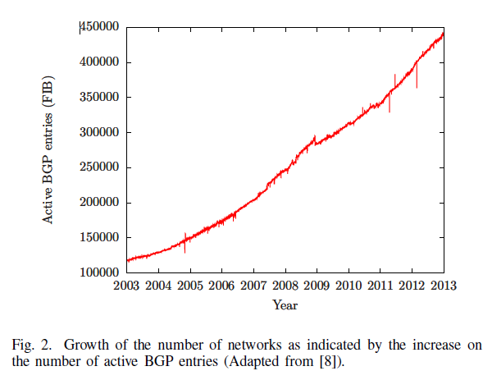
Growth of BGP entries

Slide 5
Challenges in Future Internet Routing
Most challenges faced by the Internet today are consequences of the architectural design decisions and unexpected fast growth.
Original internet design did not anticipated following trend:
  Mobility
  Multihoming
  Multipath
  Path Customization

Slide 6
Problems of Current Internet: Mobility
TCP operation in wireless environment
  Created to work for wired environment
  Wireless and mobile environment increasing more in future
  Experiencing packet loss will trigger congestion control which will reduce packet transmission rate.
  In wireless environment, it doesn’t work.

Slide 7
Problems of Current Internet: Mobility
Addressing and routing in Mobile environment
  Hierarchical structure allows network prefix aggregation.
  It improves routing scalability.
  The hierarchical structure of the Internet has led to a geographical organization of IP addresses.
  IP addresses play roles of identifier as well as locator which reflects geographical location → overloaded semantics
  Fundamental obstacle to mobility
  A station must always reconfigure its address to one topologically coherent with the visited network.
  It takes time, and is possible to lose packet during this period.

Slide 8
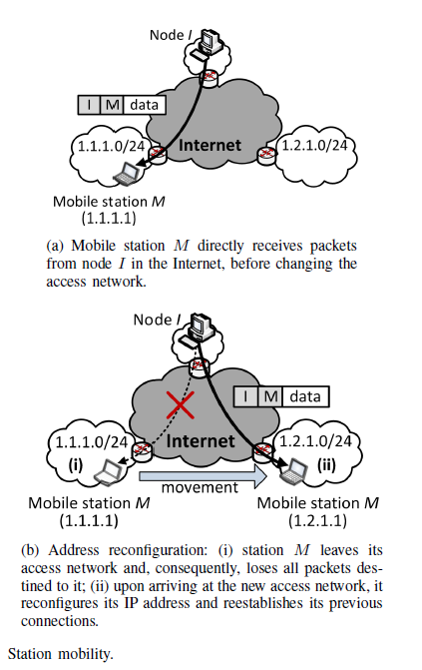

Slide 9
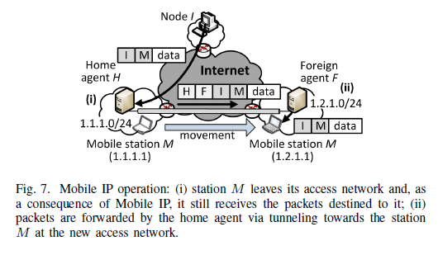
Current Internet state for mobility – Mobile IP

Slide 10
Current Internet state for mobility
MIPv6 does not require FA.
  The tunnel is established btw HA and mobile node.
  Using routing header extension, corresponding node can send packet directly mobile node without going through HA.
  This improvement is only possible in fully routable IPv6 networks.
  IPv6 has not been fully applied in practice.
Reason for this problem: overloaded semantics (locator + identifier)

Slide 11
Problems of Current Internet: Multihoming
2 cases: multihomed stations and networks
Multiple IP addresses or more than one access network from disjoint address prefixes, probably from different ISPs.
Good to avoid address reconfiguration
Not assigned by ISPs (not provided assigned), but assigned by a Regional Internet Register (RIR)
Multihomed network is independent of the ISP.

Slide 12
Advantages of multihomed network
Increased communication reliability
Used for Traffic engineering, throughput maximization, and cost reduction
  More expensive ISPs are used for sensitive traffic whereas cheaper ones are used otherwise)
No need to reconfigure network address after an ISP change.

Slide 13
Problems of multihomed nework
Scalability
  Non-aggregated prefixes must be announced to all ASes in the Internet, violating hierarchical address organization.
  In the last few years, the number of BGP entries has exponentially increased and is still moving up.
  From 2012 January to 2013 January, approximately 50,000 new active BGP entries have shown up.
We need to have better solution for multihomed network.

Slide 14
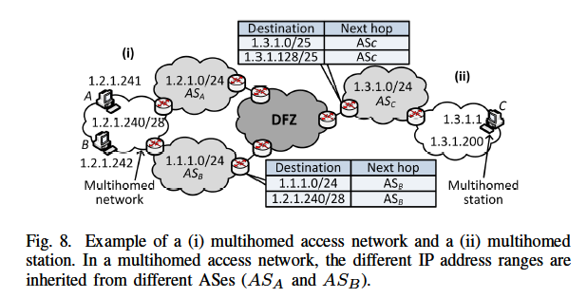
Example of Multihomed station and network

Slide 15
Problems of current Internet: Multipath
Originally, the Internet was designed based on single-path routing.
Advantages of multipath routing
  Increased available bandwidth, so provides shorter delays
  Increased fault tolerance
  Traffic engineering and load balancing possible.
Obstacles for deployment
  Scalability from storing multipaths to every other destination
  Commercial agreement among ISPs
  Traffic control such as congestion control becomes more difficult.

Slide 16
Programmable path
If users are able to configure paths, then Internet paths will be decoupled from routing protocols and agreements of ISPs.
  The best path could be chosen according to user-level requirements.
  The Internet must handle user-level metrics and the current ISPs would have to be adapted to provide this new customized service.
  The freedom for users to choose paths can stimulate competition, and it leads to a reduction on the access costs.
Disadvantages
  Increased complexity: users or agents would need wide network knowledge.
  It may require nodes maintaining multiple customized paths, impacting scalablity.

Slide 17
Programmable path
SDN could be an example for this trend.
  It neither radically changes the forwarding elements nor the contents of a packet.
  Controller manages the forwarding table of a switch via a programmable interface.
  Control decisions are taken by an external controller regarding path programmability.

Slide 18
Router Scalability
One of the most critical challenges in Future Internet design.
  The unlimited increase on the number of entries in FIBs and RIBs may impact the performance of packet forwarding.
  Since the beginning of the 1990’s the number of active BGP entries in FIBs has increased from a few hundreds to approximately 450,000 entries.
  Partial address aggregation’s side effects are obstacles to the Internet growth because of the address lookup and message processing time.
  Proposing new algorithms to improve router scalability is a major challenge to the new Internet architecture.

Slide 19
Scalability Threats
Hierarchical organization and the consequent address aggregation aim at routing scalability.
Threats
  Multihoming
  Multipath
  Mobility
  Path programming
  Transition to IPv6 (almost unlimited networks are possible.)

Slide 20
The proposed solution
Many researches has conducted to solve future internet challenges. The classification of the researches as following:
  Loc/ID split
  Flat Routing
  Network Mobility
  Multiple Paths forwarding
  Content-based routing
  Programmable paths
  Scalability
The first 4 does not affect much existing structure, but following 2 may change the structure. The last scalability issue is understandable.

Slide 21
Locator-identifier split (Loc/ID split)
One of the proposals to incorporate mobility and multihoming to the Internet is to decouple station topological locator from its identifier.
The solution trying to solve overloaded semantics of the IP address that limits the mobility and multihoming.
Overloaded semantics of the IP address is caused by the role of IP address such as:
  “who”: endpoint identifier, as used by transport layer
  “where”: locators for the routing system
  “how”: the way to sent IP packets to their destination

Slide 22
Locator-identifier split (Loc/ID split)
Loc/ID split solution can be divided into three subclass:
  Indirect forwarding
    Uses an intermediate system to maintain end-host’s identification and corresponding location.
  Network based approaches
    This approaches uses a network locator for forwarding procedures in internet default free zone (DFZ) and an end-host identifier within a local scope at the network borders.
  Host based approaches
    This approaches uses global end-host identifiers to establish end-to-end communications.

Slide 23
Loc/ID Split – Indirect Forwarding
The first approach is Internet Indirection Infrastructure (i3).
Internet Indirection Infrastructure (i3) offers rendezvous-based communication abstraction.

Slide 24
Loc/ID Split – Indirect Forwarding
Figure (a) illustrate the process of ID and IP Address information to the i3 server structure.
Figure (b) illustrate the Packet Forwarding process when the Source A send the Packet to Destination with ID is B.

Slide 25
Loc/ID Split – Network Based Approach
Locator/Id Split Protocol (LISP) is one of the proposal in this approach.
LISP focuses on Multihoming.
Internet Multihoming is one site or host can have more than one IP address; from more than one Internet Service Providers (ISP).
Internet Multihoming goals is to eliminate network connectivity as a potential single point of failure (SPOF), in other word, its increases communication reliability.

Slide 26
Loc/ID Split – Network Based Approach
The negative impact of Multihoming is internet scalability. This problem regarding to BGP table growth when multihoming add more entry to the global routing table.
Another problem is that using a single address field for both identifying a device and for determining where it is topologically located in the network requires optimization along two conflicting axes: for routing to be efficient, the address must be assigned topologically; for collections of devices to be easily and effectively managed, without the need for renumbering in response to topological change (such as that caused by adding or removing attachment points to the network or by mobility events), the address must explicitly not be tied to the topology.

Slide 27
Loc/ID Split – Network Based Approach
The approach that LISP takes to solving the routing scalability problem is to replace IP addresses with two new types of numbers:
  Routing LOCators (RLOCs), which are topologically assigned to network attachment points (and are therefore amenable to aggregation) and used for routing and forwarding of packets through the network
    Routing efficiency.
  Endpoint Identifiers (EIDs), which are assigned independently from the network topology, are used for numbering devices, and are aggregated along administrative boundaries.
    Mobility and multihoming
Both RLOCs and EIDs are syntactically identical to IP addresses.

Slide 28
Loc/ID Split – Network Based Approach
Figure (a) illustrates the direct forwarding process in LISP.
Figure (b) when there is no mapping information in source RLOC, LISP perform Map-Reply process to get new Map information and store it.
Protocol required for getting mapping information

Slide 29
Loc/ID Split – Host-based Approach
One of the approach in Loc/ID split is Host Identity Protocol (HIP)
The HIP supports an architecture that decouples the transport layer from the IP layer by using public/private key pairs, instead of IP addresses, as host identities.
When a host used HIP, the overlying protocol sublayer (Socket connection or SA (security association)) are bound to representations of these host identities, and IP addresses are only used for packet forwarding.

Slide 30
Loc/ID Split – Host-based Approach
To overcome the deficiencies of current Internet, HIP formally proposes a new architecture for Loc/ID split using the concepts of:
  Identity, an abstraction to identify the node.
  Identifier, a binary sequence used in the identification process.
Identifier in HIP consist of:
  Host Identifier: a public cryptographic key used as a name for Host Identity.
  Host Identity Tag (HIT): A 128-bit datum created by taking a hash over a Host Identifier (public cryptographic key)
In host identification, HIT is used as a host name that globally known.

Slide 31
Loc/ID Split – Host Based Approach
Cryptographic key is given to each node for security reason.
This key is used as an identity.
Using hashing, this various size key is converted to the HIT (Host Identity Tag) which is uniform size as well as globally unique.
Each node needs to register its HIT-IP address pair to the server. It helps mobile node and multi homing.
When application or TCP process tries to bind, it uses HIT.
  But to communicate each other, HIT should be resolved into IP address Using server. (is called HIP)

Slide 32
Loc/ID Split – Host-based Approach
HIP introduce Rendezvous Server (R) as a place to match HIT with the IP Address.
Figure (a) illustrates Rendezvous Server Forwarding in HIP for first packet sent.
Figure (b) illustrates packet forwarding process after the connection is formed between source and destination.

Slide 33
Loc/ID Split – Host-based Approach
To know the HIT of the nodes in HIP, there are three alternative configuration:
  First, configure the HITs of the peer hosts directly into the application.
  Second, change the mapping from DNS names to IP addresses in a way that resolving a DNS name returns a HIT, instead of an IP address, to the application.
  Third, introduce Resource Record for the Domain Name System. Resource Record store Host Identity (HI), Host Identity Tag (HIT), and the domain names of its rendezvous servers (RVSs).

Slide 34
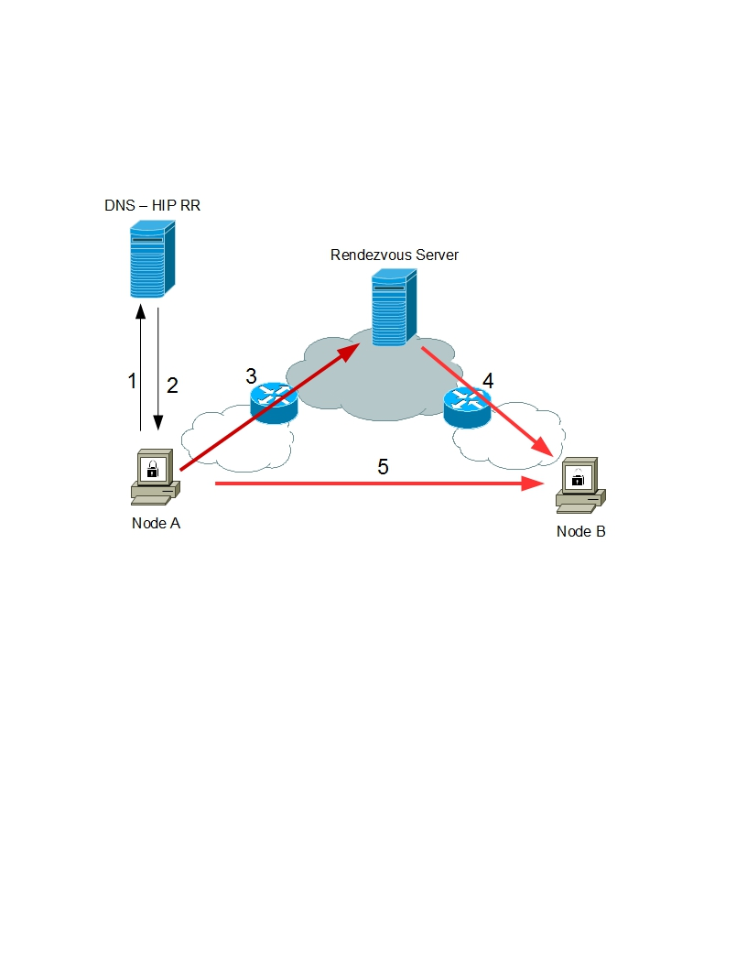
Loc/ID Split – Host-based Approach
Illustration of implementation Simple DNS-HIP Resource Record (RR).
First step, Node A send the request to DNS to get the HIT of Node B. The request contain the host name of Node B and request type is HIP.
If the DNS contain the info about host name Node B, DNS will reply back the request with Node B HI, Node B HIT and Node B RV Server IP address.
Node sent the first packet contains Source IP, Node B RV Server IP address, HIT Node A and HIT Node B.
If Rendezvous Server have HIT Node B, Rendezvous Server will forward the packet into Node B.
Next packet, will direct forwarding from Node A to Node B.

Slide 35
Loc/ID Split – Host-based Approach
End-host mobility and multihoming
  HIP mobility includes IP address changes to either party. A system is considered mobile if its IP address can change dynamically for any reason like DHCP or Network Address Translation (NAT). When this happen, the host have to remapping its translation to Rendezvous Server and DNS.
  For multihomed host, HIP links IP address together. When multiple IP addresses correspond to the same Host Identity, and if one address become unusable, or a more preferred address become available, existing transport associations can easily be moved to another address.

Slide 36
Flat Routing
Flat Routing is another possibility to circumvent the IP address overloaded semantics.
Background problem is same with Loc/Id split approach. But rather than split identity from location like in Loc/ID split approach, Flat Routing uses labels based on DHTs to identify nodes and uses DHT-based protocols.
This approach inherits all the advantages of Loc/ID split and as an addition:
  No new infrastructure: DNS like infrastructure is no need.
  Simpler allocation: allocation identity in flat routing only need uniqueness.
Flat names:
  Semantic free referencing
  Use Distributed Hash Table (DHT) as a replacement for Domain Name Services (DNS)

Slide 37
Flat Routing
Flat Routing perform connection from Hosting Router to the nodes. Then perform connection between Router to Successor Router and Predecessor Router.
The figure illustrate the element of Flat Routing

Slide 38
Flat Routing
Flat Routing consider intradomain and interdomain packet forwarding process.
In intradomain, Packet forwarding from source to destination goes through routers hosting all the required successor nodes in the path.
The figure illustrates this process.

Slide 39
Flat Routing
Illustrates flat routing communication in intradomain can be seen in the figure:

Slide 40
Network Mobility
IP addressing is the main reason mobility is very difficult in the Internet.
In the condition that neither Loc/Id split nor flat routing approach are practical short-term solutions, it will be interesting to improve Mobile IP.

Slide 41
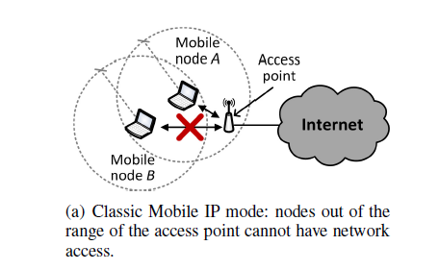
Classic Mobile IP node

Slide 42
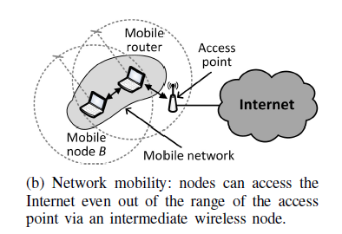
Network Mobility (NEMO) basic operation

Slide 43
NEMO
Its basic architecture concentrates into the MR.
  Updates such as CoA obtained from a foreign network
  Consequent tunnel establishment is hidden to all other mobile node.
MR sends update messages to its home agent, which associates the MR IP address in the foreign network (CoA) to a network prefix
All packets destined to one of the mobile network nodes are encapsulated and tunneled by the home agent to the MR.

Slide 44
Network Mobility
NEtwork MObility (NEMO) improves Mobile IP approach to serve mobile network.
Mobile Router act as a Gateway for mobile network. The figure show the illustration of basic NEMO architecture.

Slide 45
Content Activity based Short-cut Routing in Content Centric Networks
Tao Liu, Ming Tian, and Dongnian Cheng
National Digital Switching System Engineering Technological R&D Center
Zhengzhou

Slide 46
Basic Idea of Content-centric Networking
With the development of audio and video applications, the main function of Internet has changed from end-to-end host communication to content distribution.
The core idea of CCN is directly naming content and routing based on content names
CCN nodes have not only traditional routing and forwarding capabilities but also content caching capabilities.

Slide 47
NDN (Named Data Networking)
The latest CCN design
2 types of messages: Interest, Data
Once an Interest packet reaches a storage node or server that has stored the request content, a Data packet is produced and passed to the consumer along the reverse path.
Data packet is cached at the on-way nodes for subsequent use.
It is not efficient because nodes cannot be aware of cached content copies of each other, leading to a low cache utilization as well as a waste of transmission resources.

Slide 48
Short Cut Routing Design
The basic ideas of the short-cut routing :
  Near-abroad notification : Nodes notice the most recently active cached contents to its neighbors, making the coverage of contents to expand. The longer contents are in the cache node, the farther they are noticed
  Optimal Content Source Selection : Nodes which have received notifications establish “local map” of contents, i.e. short-cut routing table, so as to conduct optimal routing decisions

Slide 49
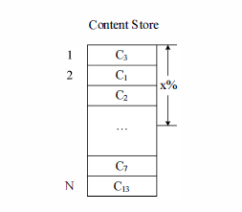
Short Cut Routing Design
Router Caching
  The dynamic nature of cached contents is an important factor that affects routing performances
  The higher the activity (the most recent activity), the longer a content item is in cache
  The position of the content object in the cache reflects its activity, position 1 represents the highest content activity while position N the lowest
  Choose the most active cached items, such as the former x% to be noticed. The others may be replaced soon.

Slide 50
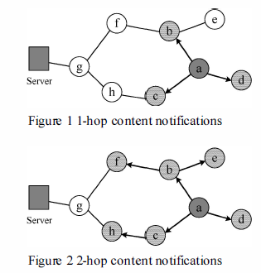
Short Cut Routing Design
Contents Notification
  Assuming that node a caches content C
  a sends notification messages containing C's name and content activity to its neighbor nodes within n hops
  Figure shows 1 hop notification (upper) and 2 hop notification neighbors (lower)

Slide 51
Short Cut Routing Design
Considering different level of content in cache, hot content items may stay in caches for a long time
They can be noticed in a larger scope, while cold contents only for a smaller scope like 1 hop or 2 hop

Slide 52
Short-Cut Routing table construction
When received a notification message, nodes create a short cut routing table entry which contains content name and next hop face (possibly multiple)
How to select the appropriate content source?
  Full / random/ minimum hop forwarding

Slide 53
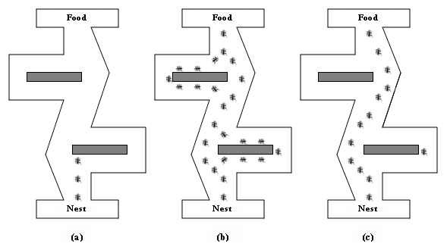
Short Cut Routing Design
Short-cut routing table construction
  To select optimal content service node, Ant Colony Optimization algorithm is used due to small hop property of short-cut routing, thus can converge fast
NODE

Slide 54
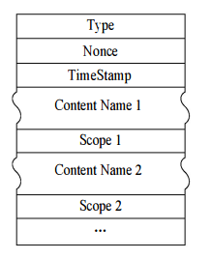
Short Cut Routing Design
Protocol format
  Type field indicates the type of message
  Nonce field is the random number
  TimeStamp field is used to record the sending time of message
  Content Name and Scope field are the name of content to be noticed and noticing range (hops) respectively

Slide 55
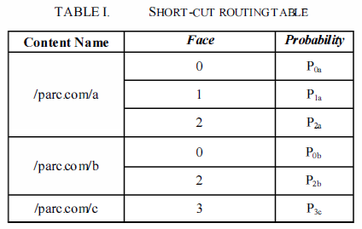
Short Cut Routing Design
Short-cut routing table construction
  To choose the optimal source, path delay, node load and content activity are used as criteria
  Each node sends probe “ant” to all service nodes to calculate the 3 criteria and then calculate forward probability and construct short-cut routing table
NODE

Slide 56
Short Cut Routing Design
Workflow
  Cache node selects contents that need to be noticed based on their activities, constructs notification packets and sets scope for these contents. Then notification packets are forwarded to all faces
  Current node which receives a notification packet checks whether the packet already exists, that is, whether the packet's content name and nonce value(is a random number, used to avoid processing same packet) are both the same with those of already exists ones. If the same, discard the notification packet, otherwise perform step 3

Slide 57
Short Cut Routing Design
Workflow
  Node checks its short-cut table. If there is an entry corresponding to the content name of the notification, node updates this entry. Otherwise, node creates a short-cut routing entry. If the scope value of notification packet is greater than 1, the value minuses 1. The notification packet is forwarded to all faces except its arriving face. If the scope value is equal to 1, do not forward.
  When changes of content in caching node reach a certain extent, or after a certain time interval, repeat steps 1-3 to update the short-cut routing table

